Slide 1



Climate Adaptation in Rural Communities: A Study of Institutional Intervention, Use of Science and Technology, and Future Goals
By: Stephanie Amaru
Director: Netra Chhetri
Consortium for Science, Policy & Outcomes

Slide 2
Research Questions
45 Case Studies
Quantitative
(1) Is there a relationship between institutional intervention in climate adaptation measures, and the degree to which science and technology are employed?
(2) Is either institutional intervention or use of science and technology associated with whether a country’s national government is democratic?
Qualitative
(1) What are common characteristics and goals among different types of case studies?

Slide 3
Institutional Intervention
Top down: implementation by outside institutions
Bottom up: implementation by community
Adaptation Strategy Type
Scientific Strategies
Technical Strategies
Experience-Based Strategies
Managerial/Organizational Strategies
Democracy
Full or Flawed Democracy
Hybrid or Authoritarian Regime

Slide 4
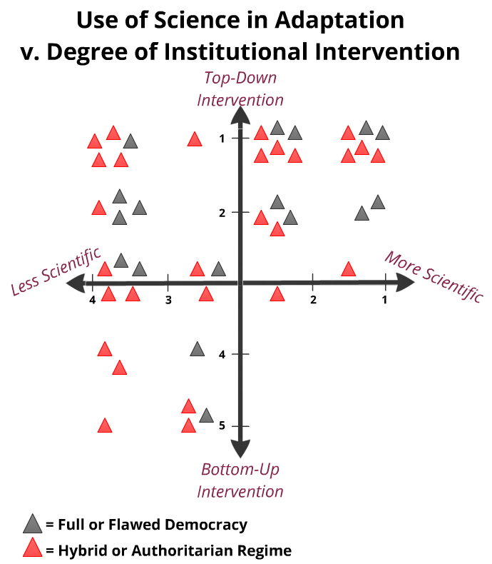
Relationships: Institutional Intervention, S&T, and Democracy
All scientific or technical adaptation measures were implemented from the top down
Most informal or experience-based measures were implemented from the bottom up
Many managerial adaptation measures were implemented from the top down.
No relationship between democracy and other variables observed among cases

Slide 5
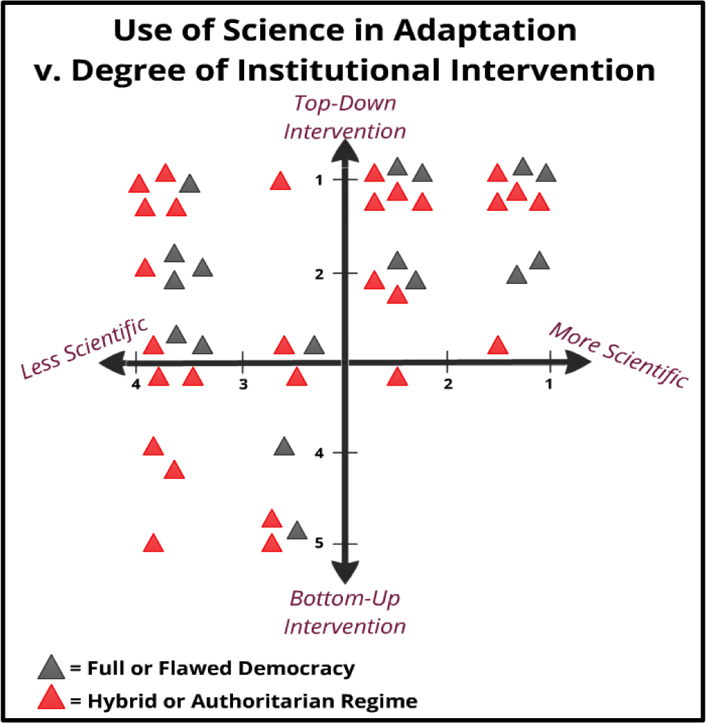
Plot of All Cases
Figure D: Each case, coded by type of government regime, is plotted according to scores on indices A and B. Q1 (Quadrant 1) shows the most scientific measures employed by the top-down institutional intervention; Q2-- least scientific/ top-down; Q3– the least scientific measures employed from the bottom-up; Q4– most scientific/ bottom-up.

Slide 6
Common Goals Across Case Studies
(1) Goal I: The need for widespread participation, flexibility, and integration of stakeholders
  Sharing knowledge, resources, and power
  Combine strengths and of top-down and bottom-up actors
(2) Goal II: Potential for success with limited institutional influence
  Self-sufficiency at the community level

Slide 7
Policy Recommendation
A global information network connecting communities to all actors and knowledge relevant to adaptation
Employment of UNDP "Facilitators" who act as liaisons among actors and enable communities' access to information, contacts, and resources
A network of information and actors can aid in the goal of integrating stakeholders and increasing self-sufficiency

Slide 8
Conclusion
It is important to examine both similarities and differences among climate adaptation case studies
While different communities have access to different resources and types of knowledge, most cases of climate adaptation share many of the same goals for future sustainability
Integration of stakeholders may help bridge the gap separating bottom-up actors and scientific adaptation strategies
A network of information and actors can aid in the goal of integrating stakeholders and increasing self-sufficiency

